Slide 1
AI4Research Workflow
How a research request becomes checked evidence, how that compares with the state of the art, and where it runs next
Muk Chunpongtong · September 2026
Notes:
TIME 0:20
SAY: This is AI4Research: how a research request becomes checked evidence, how that compares with the state of the art, and where it runs next. The capsule talk after this one builds on the freeze and the task graph.

Slide 2
1 GOAL
3 claims: the freeze, checking, and the runtime
• The talk runs the pipeline stage by stage, then the evidence so far, the state of the art, the platform and the open challenges
The freeze is the 1 boundary that matters: the plan, its capabilities and the rules that will grade it are hashed before anything runs
• Published research agents generate well and check weakly; AI4Research checks strictly and generates little
• DeepSeek Harness supplies the runtime AI4Research built by hand; the contract layer is what AI4Research adds
• Everything up to the challenges is code read in source at commit b0bf165f9; the next steps are proposed
Report §1
2
Notes:
TIME 0:45
SAY: 3 claims. First, the freeze is the one boundary that matters: before anything runs, the plan, the capabilities it uses and the rules that will grade it are hashed together. Second, published research agents are good at generating and weak at checking, and AI4Research is the opposite. Third, DeepSeek Harness gives us the runtime we built by hand, and what we add is the contract. Everything up to the challenges I read in the source at commit b0bf165f9; the next steps are proposals. The pipeline comes first, stage by stage, then the evidence, the other systems, the platform and what's still open.

Slide 3
1 SYSTEM
What AI4Research is, in 6 terms
Term | Meaning
in → out | a plain-language request → schema-checked evidence and a report
capsule | YAML contract (its manifest) for 1 capability; 80 registered, 79 manifests
operator | logical: an abstract role (45) · physical: model, CLI agent or tool (102, 63 enabled)
sprint | 1 request carried from intent to closure
gate | decides PASS or FAIL for 1 node's output
freeze | plan + bindings + grading rules hashed into 1 contract
Report §1, Table 1; harness/config at b0bf165f9
3
Notes:
TIME 0:45
SAY: AI4Research takes a plain-language research request and turns it into schema-checked evidence and a report. 6 terms carry the talk. A capsule is the contract for 1 capability, and the next talk is about those. The plan names logical operators, which are roles, and dispatch picks a physical one, a model, a CLI agent or a tool, from candidates fixed at the freeze. A sprint is 1 request end to end, a gate decides pass or fail for 1 node, and the freeze hashes the plan and its grading rules into 1 contract.
IF ASKED:
- The design target, translated from Chinese: LLMs interpret semantics; deterministic code validates structure, maintains references, freezes contracts and schedules. It is a target, not a measurement
- 80 registry entries: 77 capabilities, 1 guard and 2 resources; 74 of the 79 manifests are registered

Slide 4
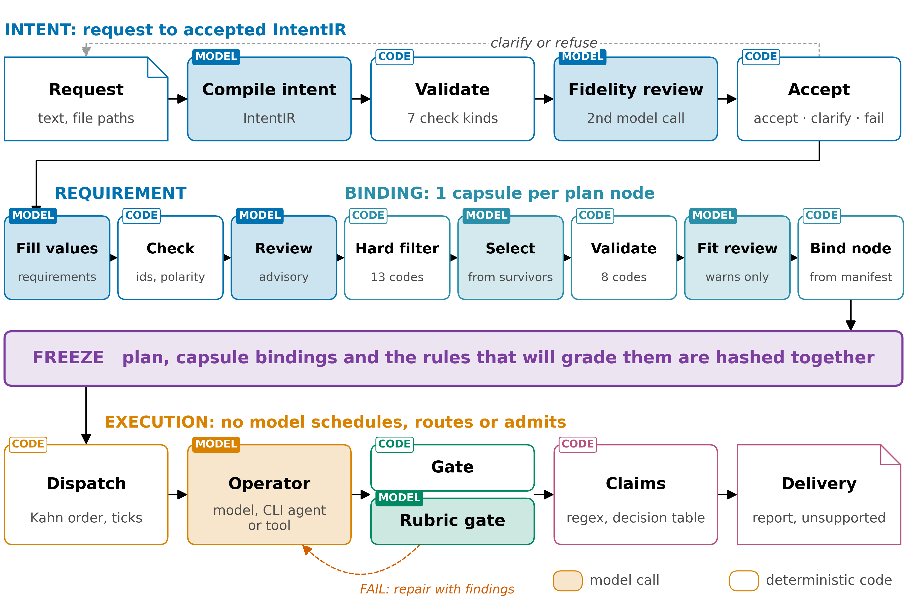
2 WORKFLOW
Models propose, code checks, the freeze fixes rules
Report §2, Fig. 1
4
Notes:
TIME 0:55
SAY: Here's the whole pipeline. Colour is the stage, a tinted box is a model call and a white box is code. Above the purple freeze band, every model call is followed by code that checks it: compile and validate the intent, fill and check the requirements, pick and validate the capsules. At the freeze, the plan, its capsules and its grading rules are hashed together. Below it, no model schedules work, routes it or admits a result. Models still run inside operators and judge inside rubric gates, and a failed gate sends the node back for repair with the findings.
IF ASKED:
- 20 of the 43 registered checks are rubrics a model judges; scheduling, routing and admission are code

Slide 5
2 WORKFLOW · INTENT AND REQUIREMENT
Before the plan, code checks every model output
IN the request text and attachment paths OUT an accepted IntentIR and a requirement contract
Step | Author | What it does
compile intent | model | IntentIR: goals, typed outcomes, constraints, blocking ambiguities
validate | code | 7 check kinds; every quote must be found in the request
fidelity review | 2nd model | does the IntentIR reflect the request? 1 repair by default, at most 4
fill requirements | model | values only: Intent ids and check ids are fixed lists in the schema
check requirements | code | constraints copied byte for byte; every Intent id covered
THUS code checks every model output; 20 of the 43 checks are rubrics, judged by a model
Report §2.1, Table 2; intent_compiler.py:1368, :782, :1272; template_contract.py:55; semantic.py:47
5
Notes:
TIME 0:55
SAY: The request becomes an IntentIR, a structured record of what was asked. The model quotes the request and code finds every quote, so it can't point at text that isn't there. A second model call checks fidelity, and in the 14-node run it caught the compiler turning 'distinguish 5 evidence statuses' into 'only these 5'; 1 repair fixed it. Then the model fills in the requirement contract, but the ids it may use are fixed lists in the schema, so it can't invent a check. And of the 43 registered checks, 20 are rubrics a model judges.
IF ASKED:
- After the repair budget, a fidelity objection becomes a warning, so a review model never becomes a second admission gate
- Nearest design: PlanCompiler (arXiv 2604.13092), 44 of 50 schema-trap tasks against 20 of 50 for GPT-4.1, not applied to research workflows
- The requirement stage makes at most 3 model calls and 1 structural repair; its reviewer is advisory

Slide 6
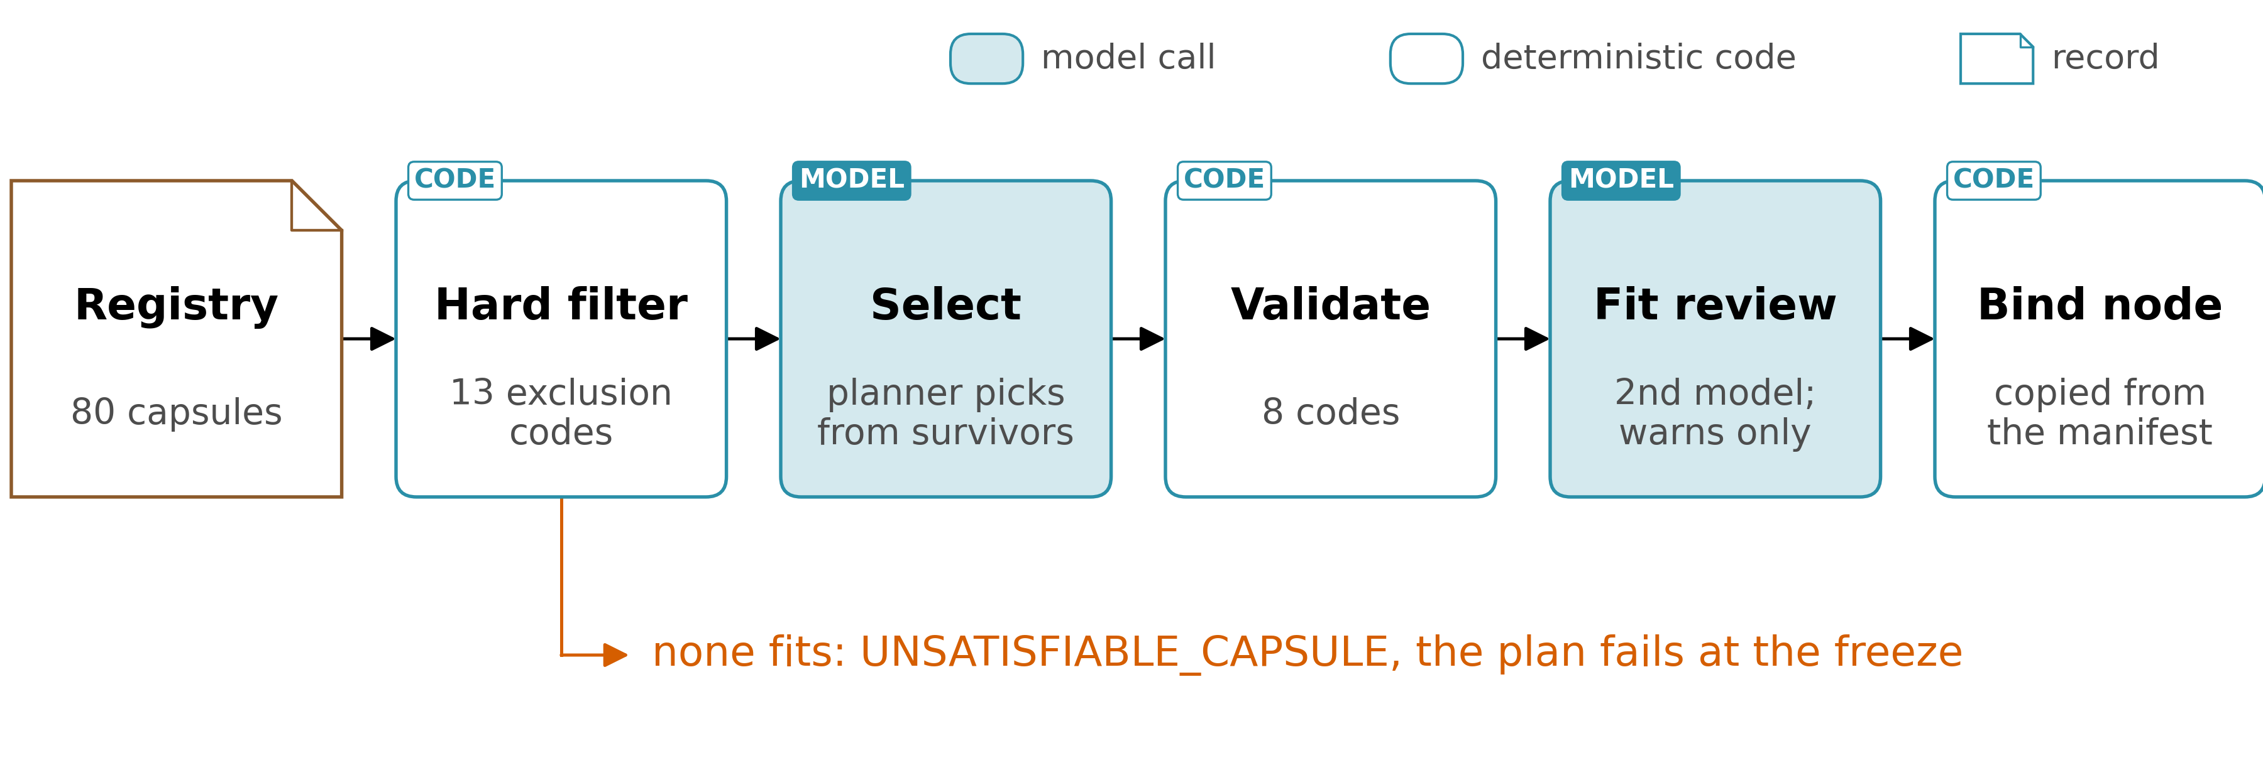
2 WORKFLOW · BINDING
Code narrows, a model picks, and code binds the pick
IN requirements, capsule registry, operators OUT a plan with a capsule and operators bound per node
THUS the model picks only among capsules code admitted; if none fits, the plan fails
Report §2.2, Fig. 2; elastic_planner.py :4553, :4727, :4815, :5685, :6270-6320; apo_plan_compiler.py:626
6
Notes:
TIME 0:55
SAY: Binding picks a capsule for each node. Before any model sees the list, a hard filter removes capsules on 13 codes: wrong types, effects that don't match the node in both directions, network rules, a missing verification contract, trust. The planner picks from what survives, code validates the pick on 8 codes, and a second model reviews the fit but can only warn. What gets bound is copied from the manifest, never from the model. And if nothing fits a node, it raises UNSATISFIABLE_CAPSULE and the whole plan fails at the freeze. The capsule talk picks that up.
IF ASKED:
- Effects in both directions: the capsule must have every effect the node needs and none it did not request
- The fit reviewer can be the same model as the planner, and the record says so
- Nearest substitutes today: a direct answer to the whole request, CLI-agent coding capsules, composition through registered adapters

Slide 7
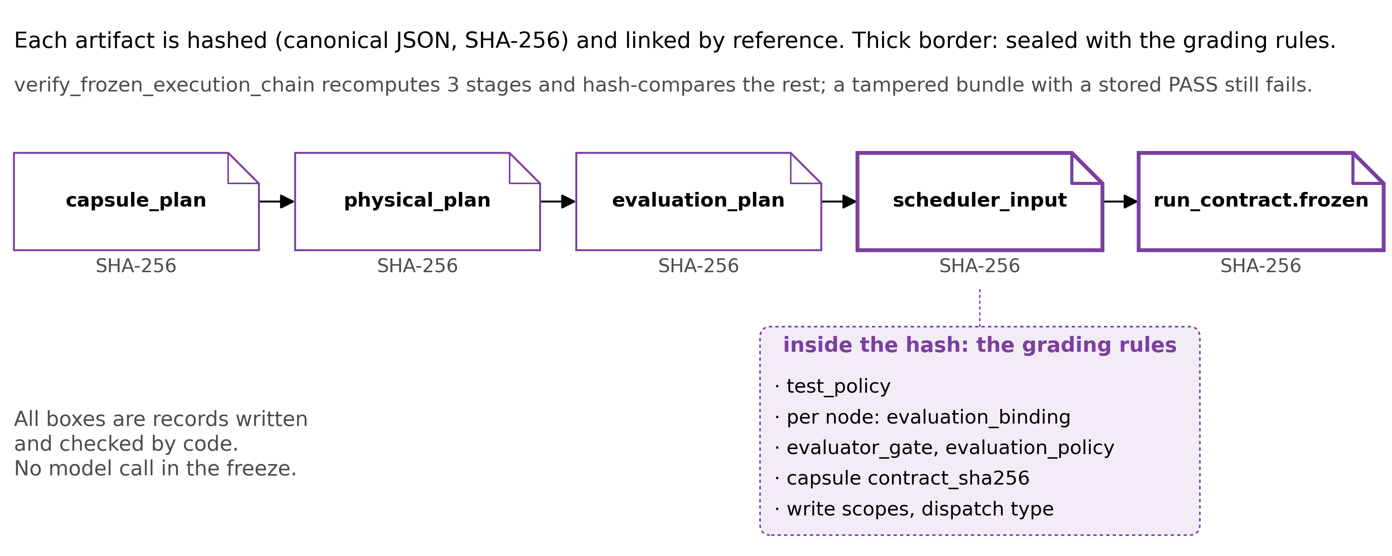
3 FREEZE
Grading rules are hashed with the plan
IN the bound plan and its evaluation plan OUT run_contract.frozen: 1 hash over plan and grading rules
Setting a frozen node's priority to 999 fails verification, though its stored verdict says PASS.
Search happens inside steps only, so a plan cannot change when execution shows it was wrong.
THUS changing what counts as success after the outputs are seen breaks the contract
Report §2.3, Fig. 3; elastic_planner.py:6802-6842, :7748-8052; test_elastic_planner.py:4697-4718
7
Notes:
TIME 1:10
SAY: The freeze is 8 steps of code, with no model. It turns the evaluation budget into a test policy first, so the grading rules exist before anything is sealed. Each artifact is hashed and linked, and the thick boxes carry the grading rules: the test policy and each node's evaluator gate. If those sat outside the hash, a run could be graded by rules chosen after its outputs were seen. This is tested: set a node's priority to 999 in a frozen bundle and verification fails, even though the stored verdict still says pass. A hash detects an edit after the fact, wherever something recomputes; it does not prevent one and it does not authenticate an author. If any of the 8 steps fails, there's no re-plan and the user resubmits. Search happens inside steps only, so the plan can't change when execution shows it was wrong.
IF ASKED:
- Verification recomputes 3 stages and hash-compares the rest
- If a capsule definition changes during planning, the freeze aborts with CAPSULE_CHANGED_DURING_PLANNING
- Nearest work: CaMeL (arXiv 2503.18813) fixes control flow, PlanCompiler a typed graph, Rel(AI)Build (arXiv 2606.26924) hashes its specification; a search on 2026-09-13 found no reviewed system that seals its own evaluation criteria in the run hash
- Arbor and Kosmos re-plan every cycle; this design trades that away for grading rules fixed in advance

Slide 8
3 FREEZE · RELATED WORK
Other work fixes the plan, never the rules that grade it
System | Fixed before execution | Not fixed
CaMeL (2503.18813), plan-then-execute security | Control flow, before untrusted data is read: 77% of AgentDojo tasks solved with provable security, against 84% undefended | Success criteria
PlanCompiler (2604.13092), compiled pipelines | A statically validated typed graph | Evaluation policy
Rel(AI)Build (2606.26924), deterministic control plane | The specification, content-hashed at approval, plus install gates, blocklists and phase transitions | Which files and tests satisfy each criterion, declared during implementation and audited afterwards
AI Scientist-v2, Kosmos, Arbor, openJiuwen auto_research | Nothing global: plans evolve every cycle or round | The plan and the rules that grade it
THUS no reviewed system seals its grading rules in the run hash (search of 2026-09-13)
Report App. E.4, Table E4; arXiv 2503.18813 p1; 2604.13092; 2606.26924 p1, p20
7a
Notes:
INSERT: optional slide; delete or hide it and the talk flows unchanged
TIME 0:45
SAY: Three families of work fix something before execution, and none of them fixes what will grade the run. CaMeL fixes control flow before any untrusted data is read, solving 77% of AgentDojo tasks with provable security against 84% undefended, and says nothing about success criteria. PlanCompiler fixes a statically validated typed graph and leaves the evaluation policy open. Rel(AI)Build content-hashes its specification at approval, and the agent declares during implementation which files and tests satisfy each criterion. The research agents fix nothing global.
IF ASKED:
- Rel(AI)Build calls its own test linkage cooperative and auditable after the fact, not enforced before execution (arXiv 2606.26924 p1, p20)
- CaMeL's 77% is AgentDojo tasks solved with provable security, against 84% for the undefended baseline (arXiv 2503.18813 p1)
- A hash detects an edit after the fact wherever something recomputes it; it prevents none and authenticates no author (Report §2.3)

Slide 9
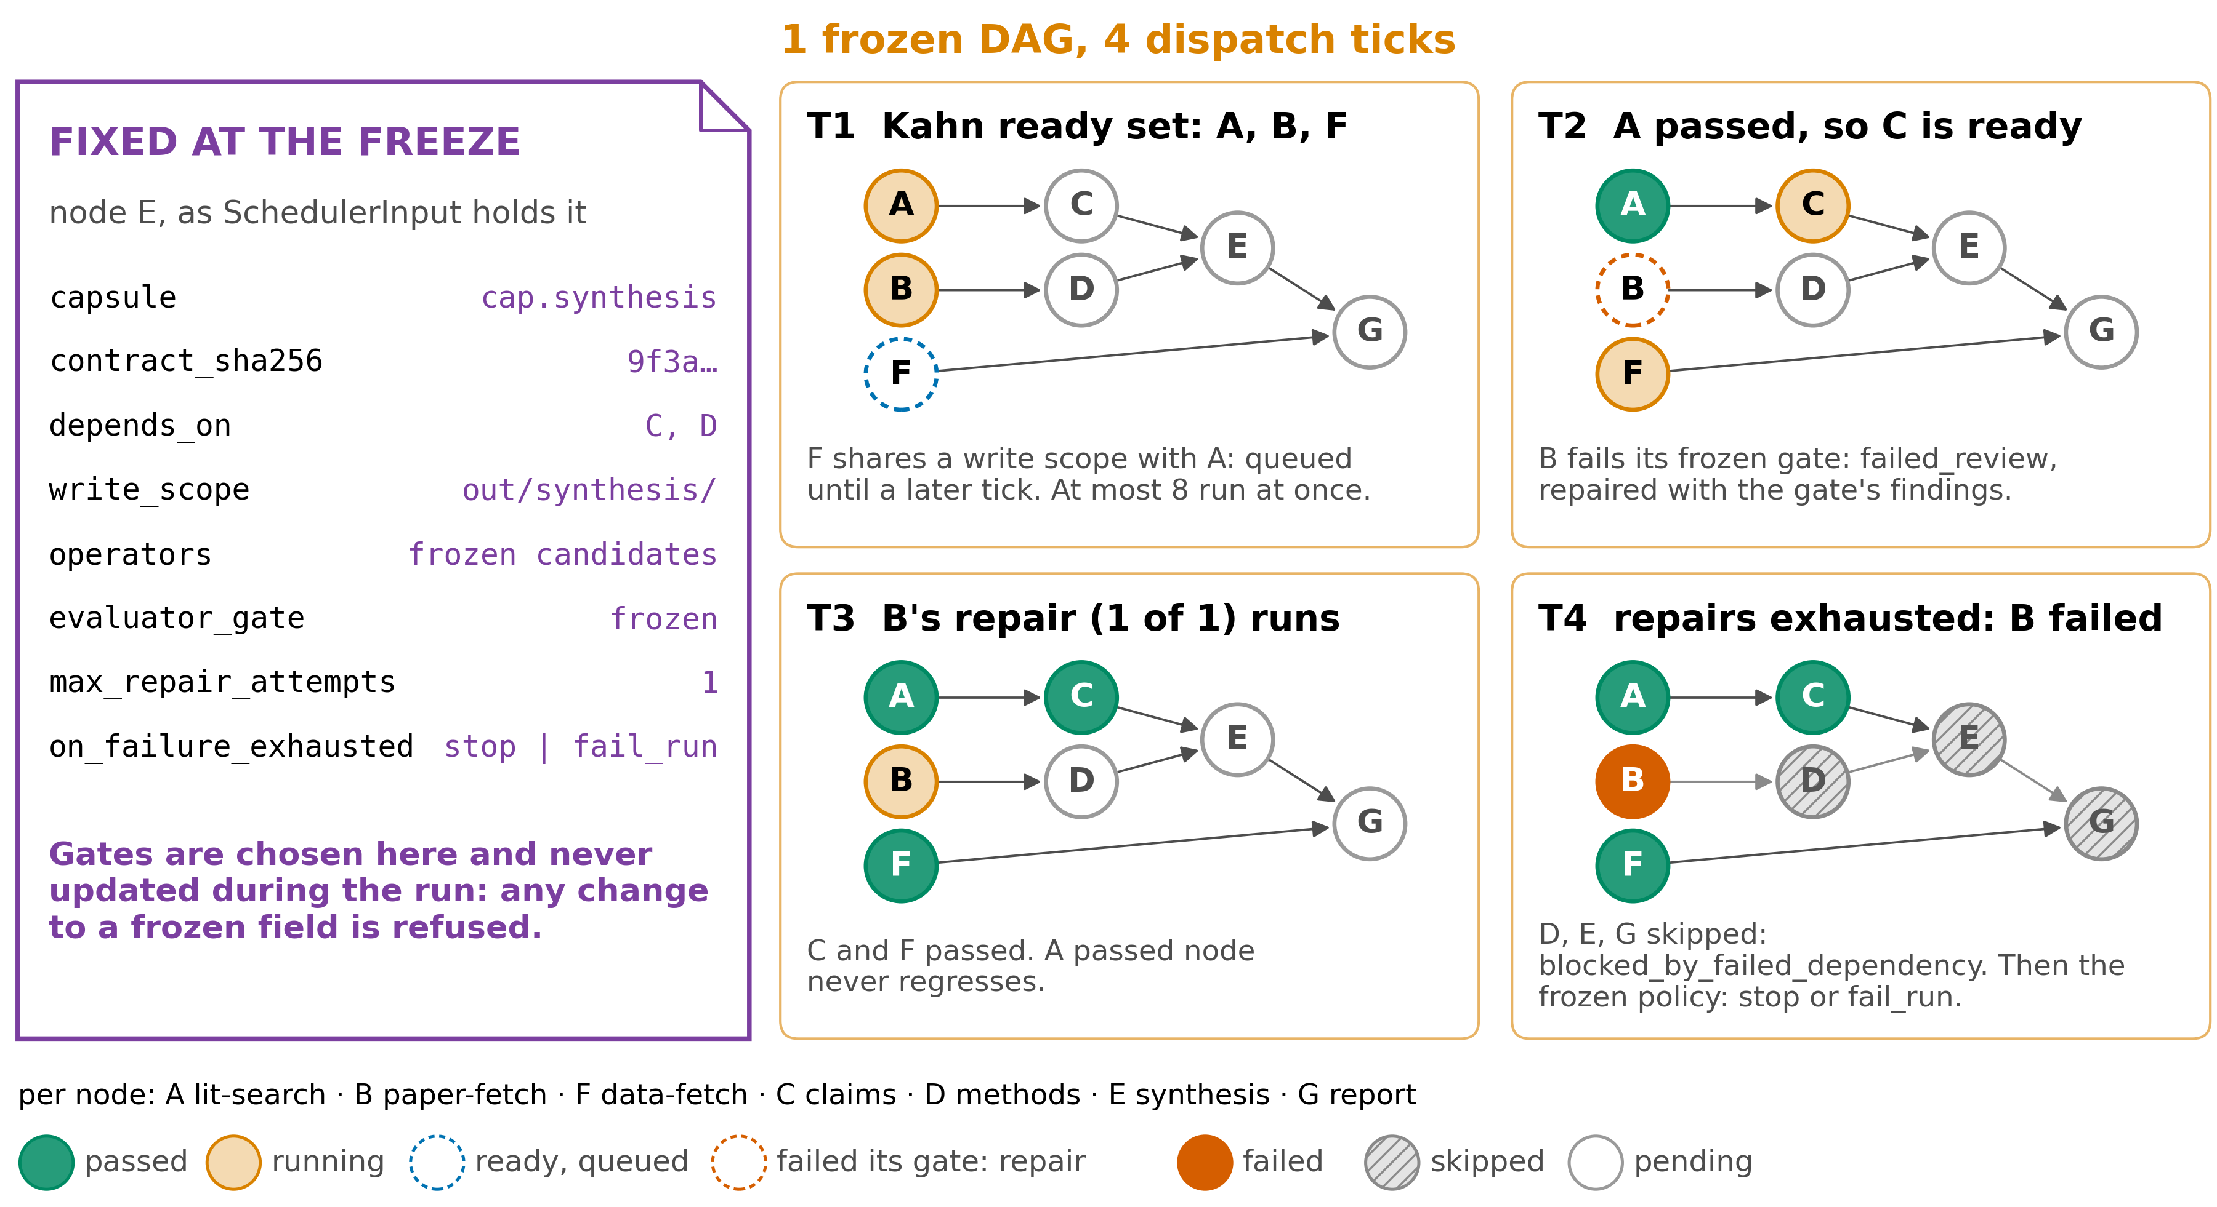
4 EXECUTION
A failure stays contained; gates never move
Report §2.4, Fig. 4; graph_scheduler.py :2008, :2179, :3200-3209, :3979; scheduler_input.py:849
8
Notes:
TIME 1:05
SAY: Execution runs in ticks, and every step of a tick is code; the ledger is the only thing that changes. On the left is what the freeze fixed for node E, including its gate, and nothing on that card can change during the run. Walking the ticks: at T1, A, B and F are ready because their dependencies passed, but F shares a write scope with A, so it waits. At T2, A has passed, so C is ready, and B fails its frozen gate and goes back for repair with the findings. At T3, B's 1 repair runs. At T4 it fails again, so B is failed, and D, E and G, which depend on it, are skipped.
IF ASKED:
- A tick is 6 steps: lock the graph and refuse if a guard fails, reconcile earlier dispatches, apply approval and the terminal barrier, verify the runtime projection and build the ready set, admit and lease, save the ledger (Report App. E.5)
- The ready set is built in 4 steps: Kahn order with ties by id, keep the nodes whose dependencies all passed, order by priority then id and take up to 8, and hold back a write-scope conflict to a later tick (Report §2.4)
- A node waiting for human review holds its dependents pending instead of skipping them
- Work envelopes are fingerprinted, so a retry never repeats a paid call
- The graph is illustrative; the rules are the code's

Slide 10
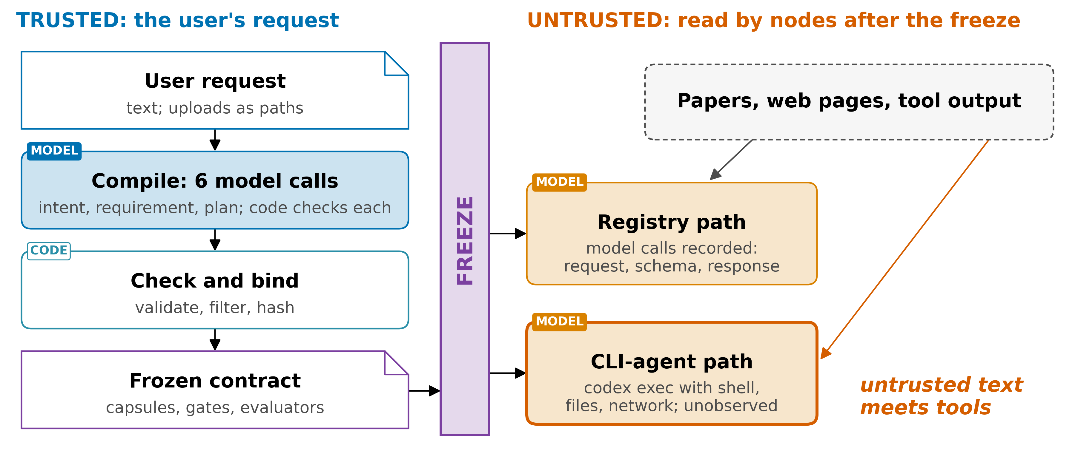
4 EXECUTION · TRUST
Nothing observes the CLI-agent path; trust ends at 1 user
THUS untrusted text reaches an agent with shell, files and network only on the CLI-agent path
Report §2.5, Fig. 5; research_operator_registry_adapter.py:268, :357; elastic_planner.py:1389-1392
9
Notes:
TIME 0:50
SAY: The user's request is trusted. Everything a node reads after the freeze is not: papers, web pages, tool output. The freeze fixes the plan before any of that is read. On the registry path, every model call is recorded with its request, schema and response. On the CLI-agent path, codex exec gets a shell, files and network, and nothing observes what it does, so that's where generality lives and trust doesn't. A fixed plan also doesn't stop planted text from steering values: a sentence planted in a paper still passes the literature check. All of this holds for 1 user on 1 machine, and a shared unattended server needs a different trust model.
IF ASKED:
- A shared server needs the CLI-agent path observed; challenge 5 proposes the sandbox logs the move to DeepSeek Harness would give (Report §6.1)
- CaMeL gives untrusted text only to a model with no tools

Slide 11
4 EXECUTION · GATES
A result does not say whether code or a model decided
IN a node's result OUT PASS or FAIL from the evaluators frozen for that node
Kind | Decides by | Note
deterministic_command | exit code (code) | timeout = infrastructure FAIL
llm_eval | separate evaluator actor (model) | model judgment
code task | patch + tests + verifier | writer ≠ verifier
registry checks | 23 Python gates · 20 rubrics | results do not mark which
THUS a receipt is not evidence: only an evaluator PASS closes a node
Report §2.6, Table 3; contract_gate_executor.py; verification_gate.py:13
10
Notes:
TIME 0:40
SAY: Every node closes on the evaluators frozen for it. A deterministic command decides by exit code, and a timeout counts as an infrastructure failure. An llm_eval gate sends the output to a separate evaluator model. A code task needs a patch, tests and a verifier who isn't the writer. The weak point: a rubric pass looks exactly like a deterministic pass in the results, and 20 of the 43 registered checks are rubrics.

Slide 12
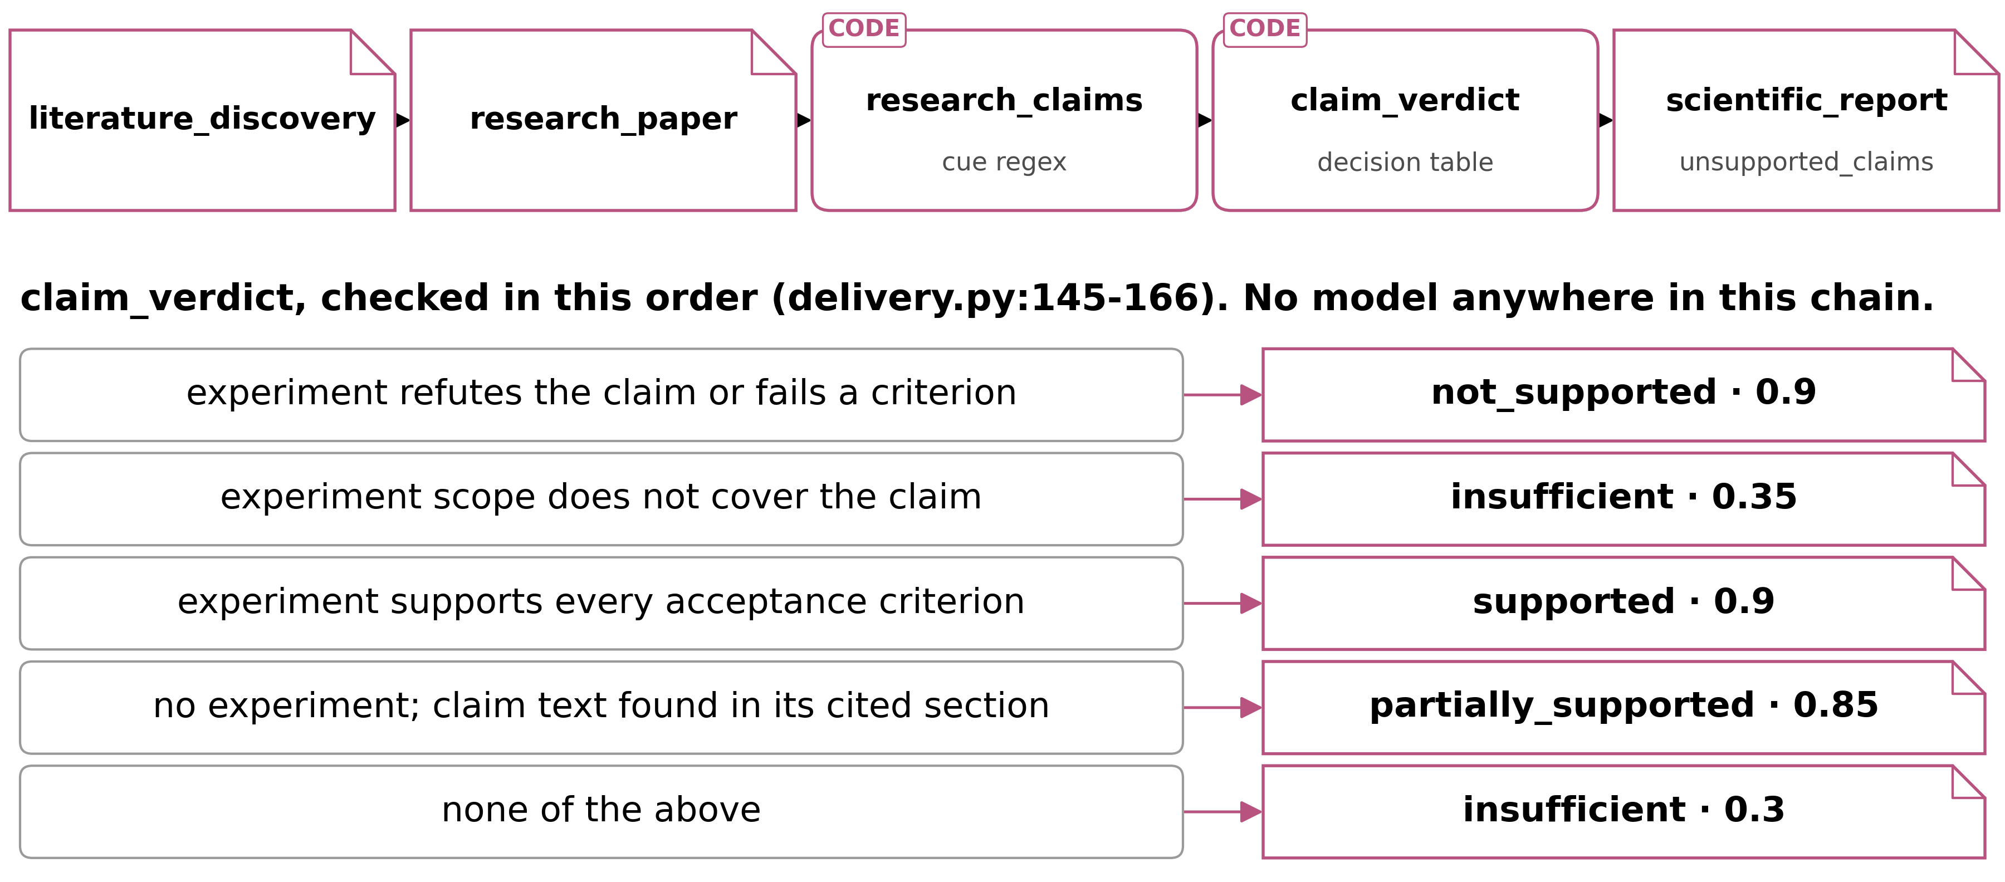
5 CLAIMS
No model extracts claims, and a verdict proves provenance
IN retained paper sections OUT claim verdicts and report conclusions with evidence status
A verdict with no experiment tops out at 0.85, and an insufficient claim still becomes a conclusion.
THUS without an experiment, the best verdict only says the sentence is in its cited section
Report §2.7, Fig. 6, Table 4; operators.py:1180-1265; delivery.py:145-166
11
Notes:
TIME 1:00
SAY: Claims are extracted by a cue-word rule, not a model, and judged by this decision table from top to bottom. Take a real test case: 'Reranker A improves ranking quality over reranker B.' The cue word 'improves' matches, the span and its section are hashed, and there's no experiment, so the table stops at partially supported, 0.85. That verdict certifies that the sentence occurs in its cited section, so a wrong or retracted paper passes. That's provenance, not truth. A claim judged insufficient still becomes a report conclusion, so the unsupported list stays empty. And a claim the rule misses never appears anywhere, so nothing shows it was missed.
IF ASKED:
- Cue words match by prefix, so 'founded' counts as 'found', and any digit makes a claim testable, a year too
- A span that fails its re-hash is dropped silently; no gate reads the span flag
- The reportable set is filtered on evidence ids rather than verdicts (delivery.py:256-261)
- The rules are English only

Slide 13
6 EXPERIMENTS
Experiment code is hand-written or unobserved
IN an approved plan with a hash-bound runner and inputs OUT measured results, or fixture-class evidence
Path | Code written by | Evidence class
native | a hand-written runner; 1 family (KV-cache quantisation) | measured_execution
adapter | codex exec (a model) | fixture_or_adapter_only
21 of the 79 capsule manifests declare a trust class, so most evidence carries no declared class.
THUS proposed: a model writes runners that run only after hash-and-approve
Report §2.8; cap.research-experiment-run.yaml; kv_cache_quantization_runner.py
12
Notes:
TIME 0:35
SAY: Experiments are the only place AI4Research measures instead of citing. The native path runs a hand-written runner whose code and inputs are hashed into the approved plan, so it can't fabricate a measurement, but there's only 1 family, KV-cache quantisation. The adapter path hands the work to codex exec: general, and unobserved. And only 21 of the 79 capsule manifests declare a trust class at all, so most of the evidence a run produces carries no declared class.

Slide 14
7 EVALUATION
1 run end to end, and 0 external scores
Evidence | Result
14-node run, 2026-09-03 | 14 nodes executed, 8 files delivered, every required gate passed
Regression, 22 files | 606 passed · 34 failed · 8 skipped
Journey tests | 24; the only acceptance evidence
External benchmark scores | 0
THUS demonstrated end to end; an unattended run from a prompt alone has not finished
Report §3.1, Table 5; stabilisation log l.793-796, l.862; phase-22-journey-test-report.md
13
Notes:
TIME 0:40
SAY: What's been shown. A 14-node run on 3 September executed every node first time after 1 bounded intent repair, delivered its 8 files and closed with every required gate passed. The regression suite has 34 failures, kept as known debt rather than relaxed away. The 24 journey tests are the only acceptance evidence. So it works end to end, an unattended run from a prompt alone has not finished, and nothing outside this repository has ever measured it.
IF ASKED:
- Passing-flag counts are not a reliable measure here, so no run count is quoted
- NOT_TESTED and ENVIRONMENT_BLOCKED are not FAIL
- An adapter for Terminal-Bench 2.0 exists, but there is no score

Slide 15
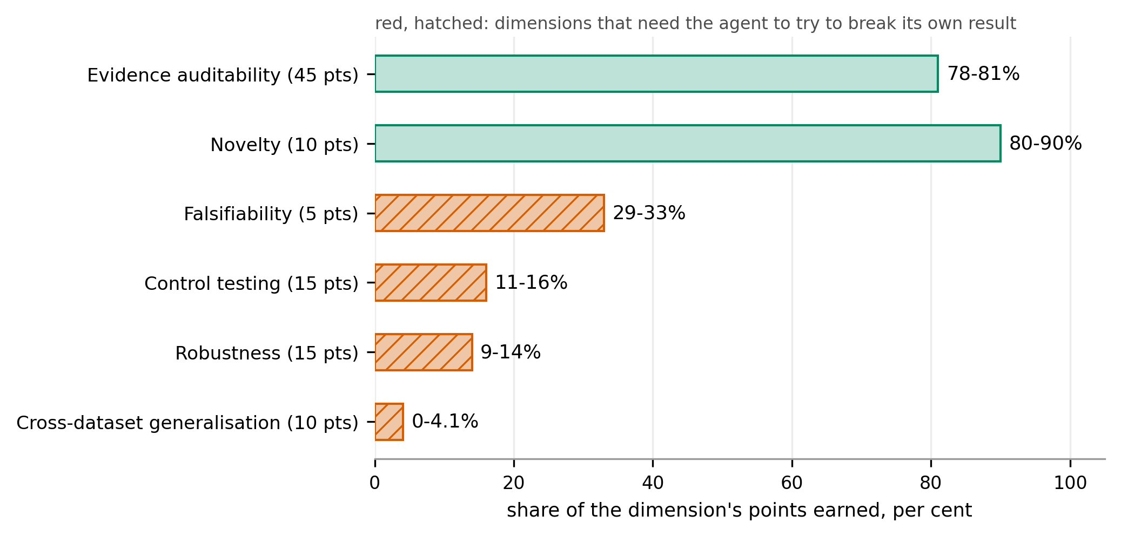
7 EVALUATION
On control testing, published agents score 11% to 16%
DEMONSTRATED BY TruthInsightBench (arXiv 2609.05079) · 40 blind tasks, 4 coding agents, 1 base model
Totals do not separate the agents (58.4 to 60.3, smallest p = 0.118), so the first external run should report each dimension.
Report §3.2, Fig. 7; arXiv 2609.05079 p1, p3, p8, p12, p14
14
Notes:
TIME 0:30
SAY: This is the first external test worth running, because what it scores is verification. The 4 agents earn most of their points for auditability and novelty, and almost none for the dimensions that need them to break their own result: 11 to 16% on control testing. Their totals sit inside 2 points of each other, so the first run should report every dimension on its own.
IF ASKED:
- A frozen model judge applies the rubric to executed artifacts; no instance is graded by a human
- 40 blind tasks from 40 peer-reviewed studies across 10 domains
- Points: evidence auditability 45, robustness 15, control testing 15, cross-dataset generalisation 10, novelty 10, falsifiability 5

Slide 16
8 STATE OF THE ART
4 reference systems generate well and check weakly
The 4 systems span the design space: generation first, scale, a held-out check, and the same thesis.
System (reported by) | Plans how | Checks with | Headline result
AI Scientist-v2 (authors, 2504.08066) | tree search per stage | execution; model and vision-language reviewers | 1 of 3 workshop papers above threshold; 57% overlap missed
Kosmos (authors, 2511.02824) | world model, re-planned each cycle | citation to a notebook or a source | 79.4% of statements accurate; 57.9% on synthesis
Arbor (authors, 2606.11926) | coordinator-owned hypothesis tree | held-out merge gate, enforced by the merge tool | Terminal-Bench 2.0 held out: 77.36 against 71.70 for Claude Code
openJiuwen auto_research (code read) | manager with a contract per round | host validation each round; rubric scoring | no published evaluation
AI4Research (code read) | compiled, frozen contract | grading rules hashed with the plan; 23 code gates, 20 rubrics | 14 nodes executed and 8 files delivered with every required gate passed; no external score
Every result here is the authors' own measurement, except openJiuwen, which is a code read.
THUS AI4Research checks the most and generates the least, and has no external score
Report §4.5, Table 6; arXiv 2504.08066 p2-11, 2511.02824 p2-4, 2606.11926 p8-10, p28; agent-core@6ecf8218
15
Notes:
TIME 0:50
SAY: These 4 systems span the design space, and 2 of them set the bar. Arbor is the closest on checking: a held-out merge gate that only the merge tool can open, scoring 77.36 on Terminal-Bench's held-out half against 71.70 for Claude Code. AI Scientist-v2 sets the bar on generating, with 1 of 3 workshop papers above the acceptance threshold and a 57% train and test overlap the reviewers missed. AI4Research checks the most and generates the least. Arbor and Kosmos re-plan every cycle, and the freeze trades that away for grading rules that are fixed before the run. Every number here is the authors' own, except openJiuwen, which I read from code.
IF ASKED:
- Kosmos runs at scale and cites every statement to a notebook or a source; experts rated 79.4% of them accurate, and 57.9% of the synthesis ones
- openJiuwen auto_research shares the design thesis and renegotiates its contract every round; it publishes no evaluation
- Arbor calls its test evaluator once, after the search; a model extracts the metric its gate compares
- Co-Scientist (arXiv 2502.18864), Robin (arXiv 2505.13400) and Agent Laboratory (arXiv 2501.04227) were read and left out: each is checked by a wet lab or a human, which AI4Research has no path to
- Should auto_research be named as the closest comparison? That is Q-G3, for the supervisor

Slide 17
8 STATE OF THE ART · KOSMOS
Kosmos cites every statement and measures accuracy later
DEMONSTRATED BY Kosmos (arXiv 2511.02824) · 102 statements from 3 reports, rated blind by experts
• A scientist supplies an objective and a dataset, and each cycle launches up to 10 parallel tasks across a data-analysis agent and a literature-search agent
• Their outputs are summarised into a shared world model, which is queried to propose the next cycle's tasks
• 1 run takes over 200 agent rollouts, writes 42,000 lines of code and reads 1,500 papers
• Every statement and figure in the report cites a publication the literature agent found or a notebook the data-analysis agent created
Experts rated 79.4% of the 102 statements accurate: 85.5% of data-analysis statements reproducible, 82.1% of literature statements validated against primary sources, 57.9% of synthesis statements accurate.
Accuracy is measured after the run rather than gated during it, and the world model is re-planned every cycle.
Its checks are citation grounding and its own execution: rungs IV and V of the ladder in the verification-gap survey (arXiv 2608.05179).
THUS the 57.9% supports keeping claims separate from synthesis, and measures nothing here
Report §4.2, Table 6; arXiv 2511.02824 p1, p2, p4; 2608.05179 p44
15a
Notes:
INSERT: optional slide; delete or hide it and the talk flows unchanged
TIME 0:50
SAY: Kosmos is the scale point in this comparison. A scientist gives it an objective and a dataset, and each cycle launches up to 10 parallel tasks across a data-analysis agent and a literature-search agent, whose outputs go into a shared world model that proposes the next cycle. 1 run is over 200 rollouts, 42,000 lines of code and 1,500 papers. Every statement in the report cites a notebook or a publication. Experts blind to both rated 79.4% of 102 statements accurate, and 57.9% of the synthesis ones. That accuracy is measured after the run, not gated during it.
IF ASKED:
- The 102 statements come from 3 representative reports, and the experts saw neither the supporting code nor the cited papers (arXiv 2511.02824 p2, p4)
- The ladder rungs are this report's own placement: the verification-gap survey classifies checks rather than systems and names none of these systems (Report §4, Table 6)
- Re-planning every cycle is what the freeze trades away (Report §2.3)

Slide 18
8 STATE OF THE ART · OPENJIUWEN
openJiuwen renegotiates its contract every round
• A module chain from topic survey through experiment design, code implementation, execution and reflection to a LaTeX report, plus standalone paper scoring
• An LLM manager that emits 1 decision each round: execute a subtask under a contract, done, or blocked
• Host-side validation that rejects illegal moves in code: executing without a ready implementation, re-executing before repair, declaring done while requirements are pending
• Budgets in the shipped config of 50 rounds, 4 code retries, 6 design revisions and 4 execution retries; the code defaults behind them are 30, 4, 5 and 3
• A claim-status classifier that is pure host code with no model call, comparing this run's numbers against a prior paper's; it is defined, and called nowhere
• Paper scoring by a dual rubric sampled 5 times at temperature 0
No results, benchmark or evaluation document exists anywhere under paper_opt/.
THUS it renegotiates its contract every round; AI4Research freezes 1 contract per run
Report §4.4, §5.4 Table 8, App. C; openJiuwen agent-core@6ecf8218
15b
Notes:
INSERT: optional slide; delete or hide it and the talk flows unchanged
TIME 0:45
SAY: openJiuwen's auto_research package is the sharpest contrast to AI4Research. It chains topic survey, experiment design, code, execution, reflection and a LaTeX report. A manager emits 1 decision a round: execute a subtask under a contract, done, or blocked. Host code rejects illegal moves, such as executing without a ready implementation or declaring done while requirements are pending. The shipped config allows 50 rounds and 4 code retries, and the code defaults behind it are lower. Its claim-status classifier is pure host code with no model call, and nothing calls it. There is no published evaluation.
IF ASKED:
- It shares the thesis that the model decides and the host validates; the difference is contract scope, 1 per round against 1 per run (Report §5.4, Table 8)
- AI4Research carries the openJiuwen name as openjiuwen-solar and shares 0 imports with it at b0bf165f9 (Report §5.4)
- Whether to name auto_research as the closest comparison is Q-G3, for the supervisor (Report §7)

Slide 19
8 STATE OF THE ART · CONSIDERED, NOT COMPARED
4 systems left out: a lab or a person does the checking
Each was read in full, and the strongest check it admits is 1 AI4Research has no path to.
System | The check it relies on | Why it is not a comparator
Co-Scientist (2502.18864) | Ranks hypotheses in a model tournament and validates the survivors in vitro | AI4Research has no wet-lab path
Robin (2505.13400) | Proposes a drug candidate and confirms it in the laboratory | AI4Research has no wet-lab path
Agent Laboratory (2501.04227) | Takes human feedback at every stage, and scores higher in that co-pilot mode than autonomously | The strongest check is a person in the loop
Towards End-to-End Automation of AI Research (2606.15497) | Repeats AI Scientist-v2's workshop experiment with the same generation-first design | The design AI Scientist-v2 already stands for
THUS the comparator set is the 4 systems whose checks AI4Research could also run
Report §4, App. A Table A1; arXiv 2502.18864 p2, p5; 2505.13400 p1; 2501.04227 p1-2; 2606.15497 p2
15c
Notes:
INSERT: optional slide; delete or hide it and the talk flows unchanged
TIME 0:40
SAY: 4 more end-to-end systems were read in full and left out, because the strongest check each admits is 1 AI4Research has no path to. Co-Scientist ranks hypotheses in a model tournament and validates the survivors in vitro. Robin proposes a drug candidate and confirms it in the laboratory. Agent Laboratory takes human feedback at every stage and scores higher that way than autonomously. And Towards End-to-End Automation of AI Research repeats the same workshop experiment with the same generation-first design as AI Scientist-v2.
IF ASKED:
- 18 sources were read in full, and each is used for 1 job (Report App. A, Table A1)
- The 4 compared systems span the design space: generation first, scale, a held-out check, and the same thesis (Report §4)

Slide 20
9 PLATFORM
DeepSeek Harness runs it; AI4Research adds the contract
DEMONSTRATED BY Claw-SWE-Bench (arXiv 2606.12344) · coding: harness 27.4 points, model 29.4
Stage | DeepSeek Harness provides | AI4Research adds
freeze | immutable versioned successors | plan hash with grading rules
dispatch | jobs, subagents, swappable services | frozen graph, write-scope checks
gates | invariants, an approval service | frozen evaluators, result vocabulary
claims | session log as evidence store | verdict gates, unsupported_claims
THUS move the workflow onto DeepSeek Harness; keep the contract layer as the contribution
Report §5, Fig. 8, Table 7; deepseek-harness docs/architecture.md:13, :121; arXiv 2606.12344 p1, p11
16
Notes:
TIME 0:45
SAY: The harness around a model matters almost as much as the model. On coding tasks, at a fixed model, changing the harness moved pass rates 27.4 points, against 29.4 for changing the model. DeepSeek Harness is a plugin harness with no privileged core, and it already does loading, swapping, reverting, sandboxing and logging. What it doesn't have is the contract: what a run must satisfy, what grades it, and what a capability may do. So the workflow moves onto DeepSeek Harness now, and the contract layer goes to openJiuwen later.
IF ASKED:
- The harness effect shrinks with stronger models, from 27.4 points on Qwen 3.6-flash to 12.5 on GLM 5.1, and it covers coding only
- AI4Research shares no code with openJiuwen today: 0 imports

Slide 21
10 CHALLENGES
No outside score, and a verdict that stops at provenance
§6.1 | Challenge | Evidence | What would settle it
1 | Nothing outside this repository has scored it | 0 benchmark scores; the 24 journey tests are internal; at every risk tier exactly 1 node of a graph gets a model evaluator (evaluation_budget.py:22), and results never say which PASS a model decided | Run TruthInsightBench end to end and read the 6 dimensions; record the deciding check kind on every verdict
2 | A verdict proves provenance, and only in English | Without an experiment the best verdict is a case-insensitive substring, 0.85 (delivery.py:155); a span that fails its re-hash is dropped and no gate reads the flag (:201), so the unsupported list is empty | Gate the failed span; filter the report on the verdict; a schema-bound extractor, tested per language
Report §6.1, Tables 9 and 10; evaluation_budget.py:22; delivery.py:155, :201
17
Notes:
TIME 0:45
SAY: Two challenges about what a result means here. Nothing outside this repository has ever scored the system: no benchmark scores, journey tests that are internal, and inside a run exactly one node of the graph gets a model evaluator, at every risk tier, with nothing in the results saying which passes a model decided. Second, without an experiment a verdict proves the sentence sits in the cited section, case-insensitively, and stops at 0.85. A span that fails its hash is dropped quietly. Both fixes are proposed.
IF ASKED:
- Human review is not the fallback: experts judge verifiable claims correctly 60.8% of the time
- The English rules sit in the negation cues and clause breaks of the request, and in the claim cues and testability rules for papers
- 20 of the 43 registered checks are model-judged rubrics, and the result vocabulary does not separate them from the 23 Python gates
- A Terminal-Bench 2.0 adapter already exists; TruthInsightBench needs one of the same shape

Slide 22
10 CHALLENGES
A frozen plan gets 1 repair, and a run needs a person
§6.1 | Challenge | Evidence | What would settle it
3, 4 | A frozen plan gets 1 repair and no recovery | 1 repair by default, then the sprint fails (intent_compiler.py:210-217); every node but the evaluated one freezes with no evaluator gate, so an unforeseen outcome records a pass; a node no capsule fits fails the plan (apo_plan_compiler.py:626) | Count defects per plan over the 24 journeys; declare halt, inconclusive or ask a person in the test policy
5, 6 | A run is recorded, not observed, and stops without a person | CLI-agent commands, files and network unobserved; 21 of 79 manifests declare a trust class; a frozen 1-attempt policy ended a run and cancelled 13 nodes after HTTP 429 (log l.814) | Move to DeepSeek Harness with sandbox logs; declare a hash-bound local-source fallback; 1 unattended journey from a prompt
Report §6.1, Tables 11 and 12; intent_compiler.py:210-217; apo_plan_compiler.py:626; log l.814
18
Notes:
TIME 0:45
SAY: Two challenges about what a run does. A frozen plan gets one repair before the freeze, then the sprint fails, and every node except the evaluated one is frozen with no evaluator gate, so an outcome nobody wrote a rule for closes as a pass. When execution shows the plan was wrong there is no re-planning, and the request goes back in. A run is also recorded rather than observed: on the agent path commands, files and network go unwatched, and one frozen attempt cancelled 13 nodes after a 429. Both fix lists are proposed.
IF ASKED:
- A coordinator once ran code 28 hours older than the file on disk; that substrate is what the move toDeepSeek Harness replaces
- The node's network rule is spent filtering capsules at planning; nothing watches the network at run time
- 13 of PlanCompiler's 22 failures routed around typed contracts; this system's own defect rate is unmeasured
- Keeping the freeze trades away the re-planning Arbor and Kosmos do every cycle

Slide 23
10 CHALLENGES · OBJECTIONS
The strongest objection to each challenge, and the answer
Challenge | The strongest objection | The answer
1 Nothing measured externally | Every pre-release system lacks an external score | The argument is a design comparison, so until 1 external result exists no quantity can sit beside Arbor or Kosmos
2 Provenance, not truth | The verdict is the honest one, and the fields say so | The fields are worth keeping. A claim judged insufficient arrives as a conclusion, and the unsupported list stays empty
3 The freeze and the unforeseen | A bounded pre-freeze loop is the design | Deliberate, except the default gate: a node outside the 1 evaluated node freezes with no evaluator gate, so an unforeseen outcome closes as a pass
4 A wrong plan, no recovery | 13 of 22 is PlanCompiler's number | It bounds the failure mode without measuring this system, and plan defects per run are counted by nobody today
5 Recorded, not observed | The coordinator incidents are dated | They are. The live part is the CLI-agent path used today: its network rule is spent at planning and nothing watches it at run time
6 Unattended runs stop | An HTTP 429 is a provider flake, so retry | The failure was already marked retryable, and the frozen 1-attempt policy ended the run. The fallback has to be a hash-bound local source
Report §6.1, Tables 9-12; App. B Table B1
18a
Notes:
INSERT: optional slide; delete or hide it and the talk flows unchanged
TIME 0:55
SAY: 6 challenges, and the strongest objection to each. On the external score: every pre-release system lacks one, and the answer is that this argument is a design comparison, so no quantity can sit beside Arbor or Kosmos until 1 external result exists. On claims: a provenance verdict is the honest one, and those fields are worth keeping, but a claim judged insufficient arrives as a conclusion. On the freeze: the bounded loop is deliberate, the default gate is not. The PlanCompiler number bounds the failure mode without measuring this system. The coordinator incidents are dated, and the agent path is live. And the 429 was already marked retryable.
IF ASKED:
- A graph gets 1 model-evaluated node at every risk tier, and a report reader cannot tell which verdicts a model decided (Report §2.6, §6.1)
- FactReview (arXiv 2604.04074) returns a claim whose link to its evidence cannot be established as inconclusive rather than carrying it forward (Report App. E.7)
- Loosening the 1-attempt policy alone would let a run continue with no evidence behind it (Report §6.1, Table 12)
- Resubmission is cheap when a plan fails at the freeze and expensive when it freezes cleanly and execution shows it was wrong (Report §6.1)

Slide 24
10 CHALLENGES · WHAT WOULD SETTLE THEM
What would settle each challenge, and what to read
Challenge | The test | The signal
1 Nothing measured externally | Run TruthInsightBench end to end on 1 frozen model | Each of the 6 dimension scores read on its own, not the total
2 Provenance, not truth | Add a gate on the failed span, then replay the delivery fixture with 1 span edited | Whether the node fails, or passes with the span dropped
3 The freeze and the unforeseen | Freeze a graph, then deliver, for a node whose evaluator gate is none, an output that fits its schema and contradicts its acceptance criterion | The verdict recorded: a policy pass measures the gap, a failure closes it
4 A wrong plan, no recovery | Replay the 24 journey requests through planning alone at 1 frozen model | Defects per plan, against the 0 the freeze assumes
5 Recorded, not observed | Run 1 experiment node on the adapter path with an outbound request placed in the runner | Whether any artifact the run retains shows the call
6 Unattended runs stop | 1 unattended journey from a prompt alone, with the provider forced to return HTTP 429 | Whether the run continues on declared local sources or cancels its downstream nodes
Report §6.1, Tables 9-12; §3.2
18b
Notes:
INSERT: optional slide; delete or hide it and the talk flows unchanged
TIME 0:55
SAY: Each challenge has a test that would settle it. Run TruthInsightBench end to end on 1 frozen model and read each of the 6 dimensions on its own. Add a gate on the failed span, replay the delivery fixture with 1 span edited, and see whether the node fails. Freeze a graph, deliver an output that fits its schema and contradicts its acceptance criterion, and read the verdict. Replay the 24 journey requests through planning alone and count defects per plan. Put an outbound request in a runner on the adapter path and look for it in the artifacts. Force a 429 on an unattended run and see whether it continues on local sources.
IF ASKED:
- An evidence-auditability rate inside the published 78% to 81% band puts the auditability claim with the field rather than ahead of it (Report §3.2, §6.1)
- A Terminal-Bench 2.0 adapter already sits in the repository, and TruthInsightBench needs 1 of the same shape (Report §6.1)
- Hand-labeling the claims of 50 paper sections would give the cue-word rule's recall (Report §6.1, Table 9)

Slide 25
11 SUMMARY
Ahead on checking, behind on generating
Ahead | Behind
grading rules sealed in the run hash | experiment code: 1 hand-built family
a claim not found in its cited section never rises above insufficient | claim extraction: English-only regex, recall unmeasured
a check that did not run is recorded as NOT_TESTED, never as a pass | external benchmarks: none
THUS the lead is a design property: the first external score decides whether it holds
Report §6
19
Notes:
TIME 0:35
SAY: Back to the 3 claims. AI4Research is ahead on checking: the grading rules are sealed in the run hash, a claim that isn't in its cited section never rises above insufficient, and a check that didn't run is recorded as not tested rather than as a pass. It's behind on generating: 1 experiment family, an English regex and no external benchmark. The lead is a design property, and the first external score decides whether it holds.

Slide 26
11 NEXT
DeepSeek Harness comes first, and 3 decisions wait
None of these 5 steps is built or measured.
• Move the workflow onto DeepSeek Harness; keep the contract layer
• Model-written experiment runners under hash-and-approve
• A schema-bound model extractor at both text boundaries, plus a span gate
• Record on every verdict which kind of check decided it
• TruthInsightBench end to end before any comparative claim
# | The decision it asks for | Owner
Q-G3 | Name openJiuwen auto_research as the closest comparison, or let Arbor stand | supervisor
Q-G4 | Approve TruthInsightBench and its adapter work, and set the date it runs | supervisor
Q-G5 | Assign challenges 1 and 4 for the next cycle | supervisor
Report §6.2, §7, Table 13
20
Notes:
TIME 0:30
SAY: None of these 5 steps is built or measured. Moving onto DeepSeek Harness comes first, then runners a model writes under hash-and-approve, a model extractor for claims, a deciding-check label on every verdict, and 1 external benchmark before any comparison. Three decisions are yours. Q-G4 unblocks the most, because it gives the first external number.

